Slide 1
BT201
Biochemical Process Calculations
31/08/2022

Slide 2
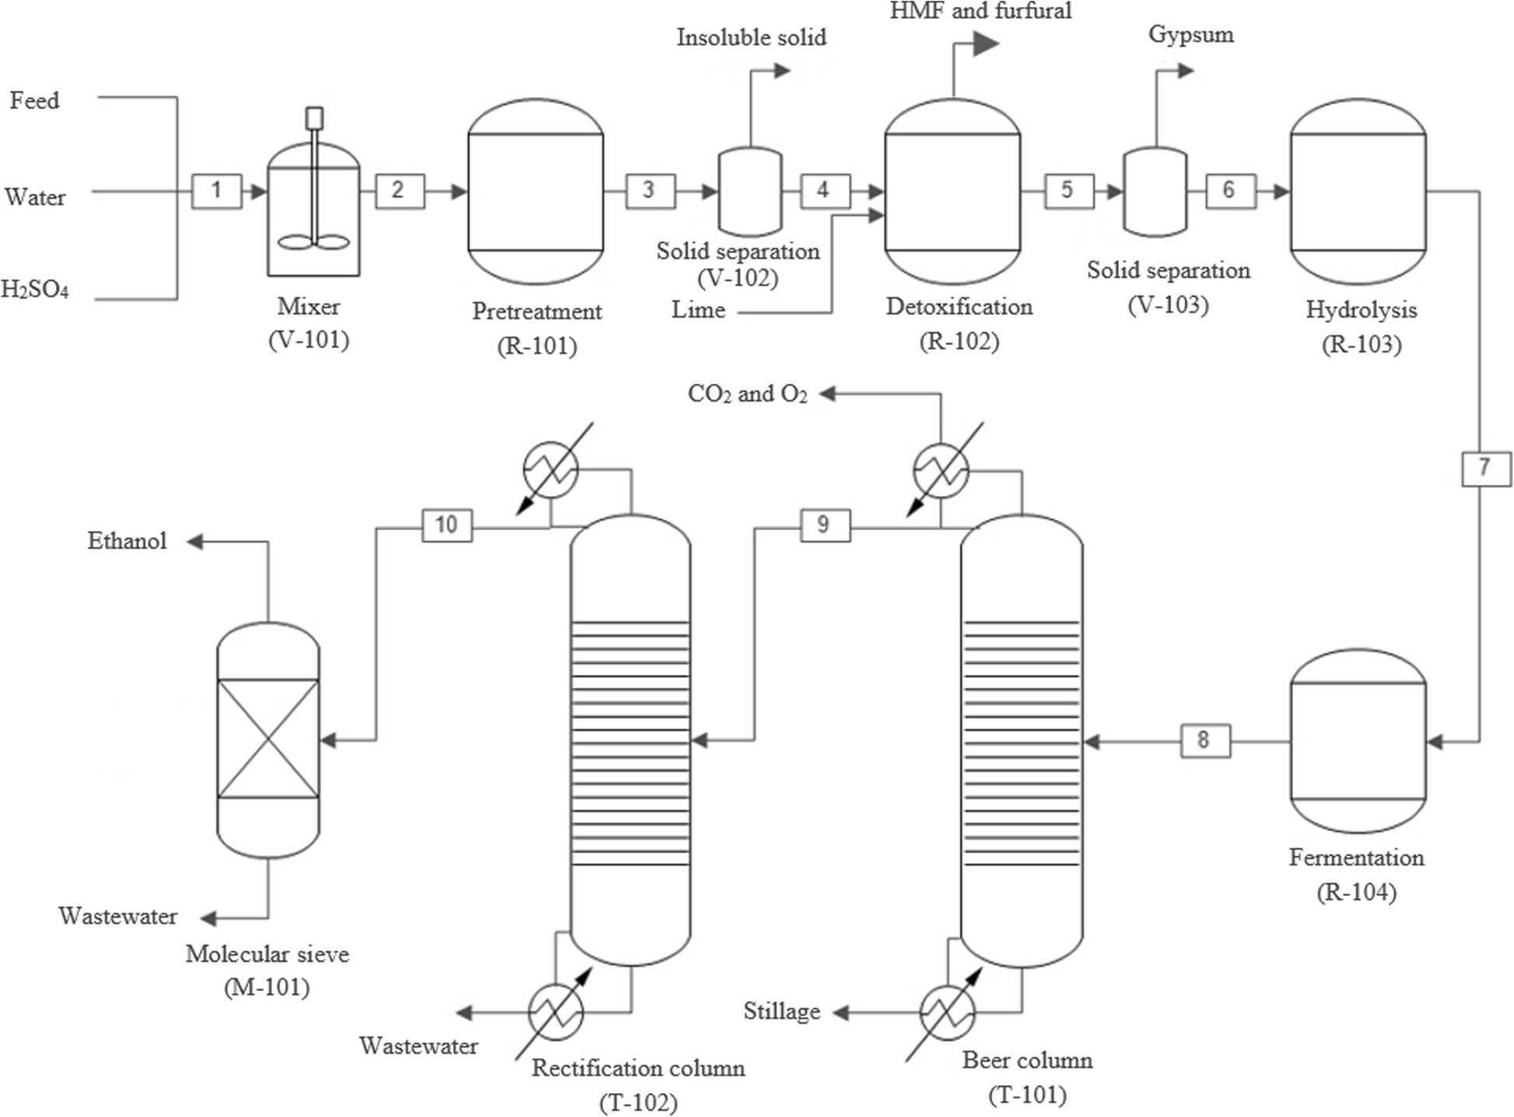
Material balances for multiple units with/without reaction
Bioethanol process flow diagram
Industrial Biochemical processes rarely involve just one process unit.
One or more bioreactors are often present, heating and cooling process streams, separating products and removing potentially hazardous pollutants from streams prior to discharging the streams to the plant environment.
Before we analyze such processes, take a closer look at what we mean by a system.

Slide 3
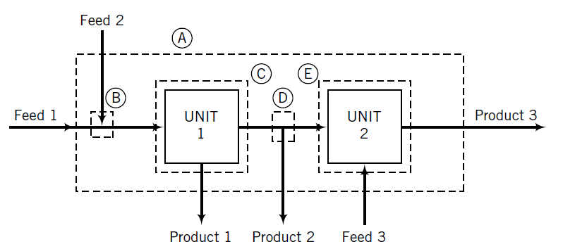
Cont.
In general terms, a “system” is any portion of a process that can be enclosed within a hypothetical box (boundary).
It may be the entire process,
an interconnected combination of some of the process units,
a single unit,
or a point at which two or more process streams come together
or one stream splits into branches.
The inputs and outputs to a system are the process streams that intersect the system boundary.

Slide 4
Cont.
Five boundaries drawn about portions of the process define systems on which balances may be written.
Boundary A encloses the entire process; the system defined by this boundary has as inputs; Feed Streams 1, 2, and 3 and Product Streams 1, 2, and 3.
Balances on this system are referred to as overall balances.
Boundary B encloses a feed stream mixing point. Feed Streams 1 and 2 are inputs to this system and the stream flowing to Unit 1 is an output.
Boundary C encloses Unit 1 (one input stream and two output streams),
Boundary D encloses a stream splitting point (one input stream and two output streams), and
Boundary E encloses Unit 2 (two input streams and one output stream).

Slide 5
Cont.
The procedure for material balance calculations on multiple-unit processes is basically the same single unit.
The difference is that with multiple-unit processes you may have to isolate and write balances on several subsystems of the process to obtain enough equations to determine all unknown stream variables.
When analyzing multiple-unit processes, carry out degree-of-freedom analyses on the overall process and on each subsystem, taking into account only the streams that intersect the boundary of the system under consideration.
Do not begin to write and solve equations for a subsystem until you have verified that it has zero degrees of freedom.

Slide 6
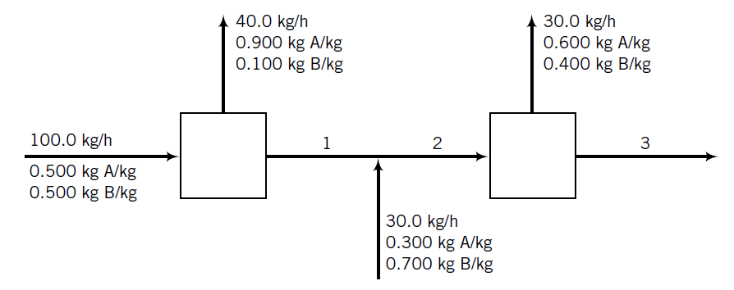
Material balances for multiple units without reaction
A labeled flowchart of a continuous steady-state two-unit process
Each stream contains two components, A and B, in different proportions.
Three streams whose flow rates and/or compositions are not known are labeled 1, 2, and 3.
Calculate the unknown flow rates and compositions of streams 1, 2, and 3.

Slide 7
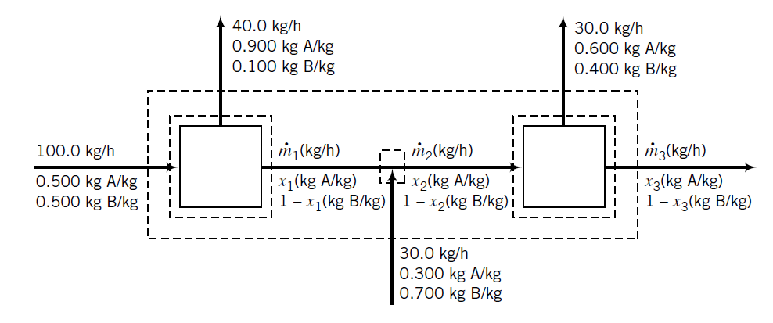
Representation of the flowchart
The outer boundary encompasses the entire process and has as input and output streams all of the streams that enter and leave the process.
Two of the interior boundaries surround individual process units, and the third encloses a stream junction point.
:
1
2

Slide 8
Cont.
We first outline the solution procedure by performing degree-of-freedom analyses on different systems. Remember that only variables associated with streams intersecting a system boundary are counted in the analysis of that system.
Overall system (outer dashed boundary):
In subsequent analyses, we may consider these two variables as known.
Suppose we decide to consider the intermediate stream mixing point as the next system.

Slide 9
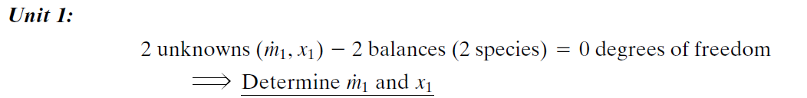
Cont.
We have too many unknowns for the number of available equations.
Try Unit 1.
We may now analyze either the mixing point or Unit 2, each of which has two unknown variables
associated with it.

Slide 10

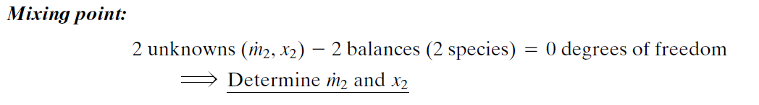
Cont.
1
2

Slide 11
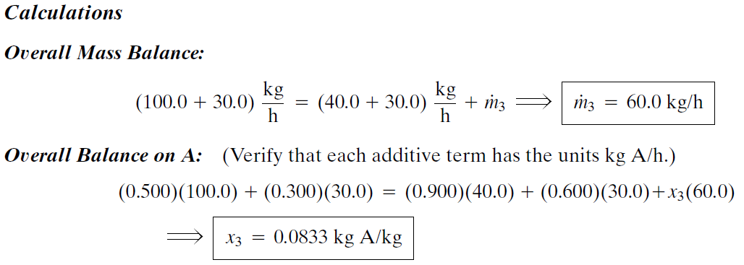
Cont.

Slide 12
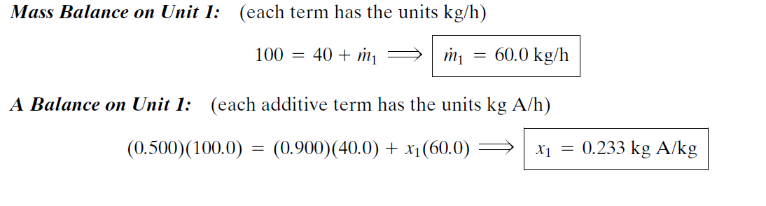
Cont.

Slide 13
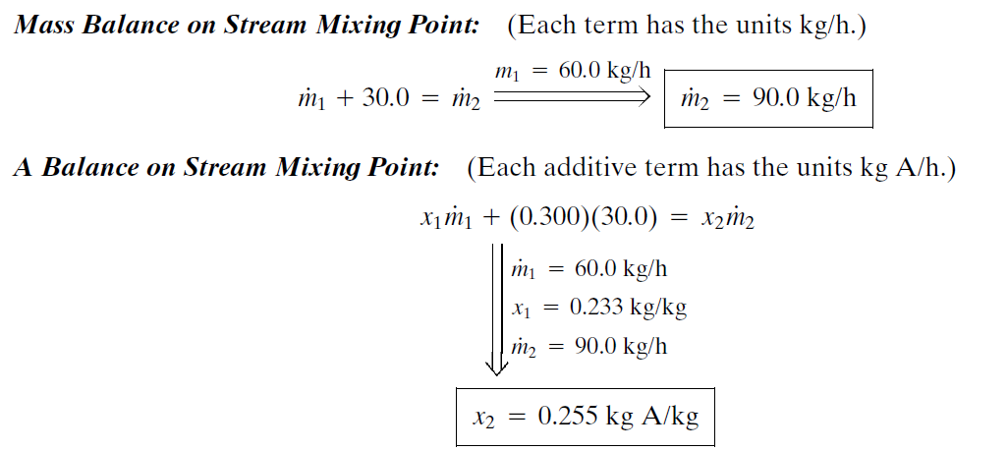
Cont.

